Slide 1
MSEIRS Model
Vaibhav Amit Patel - 201401222
Tanmay Patel - 201401409

Slide 2
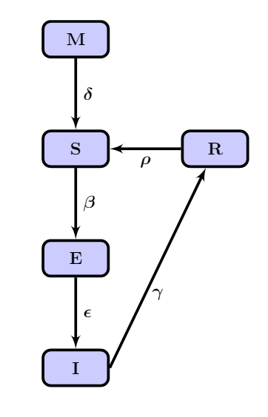
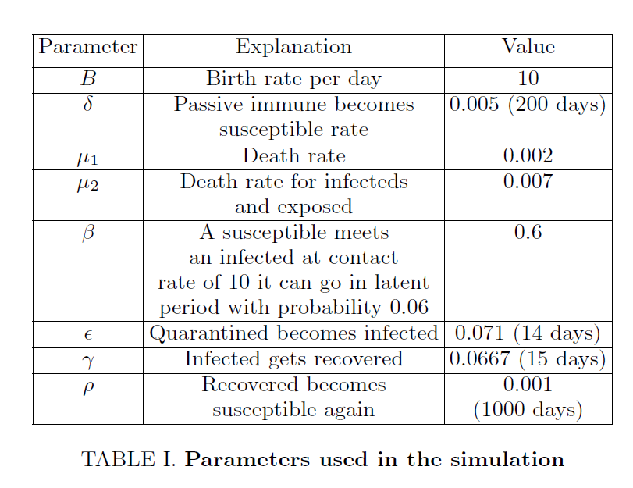
Model

Slide 3
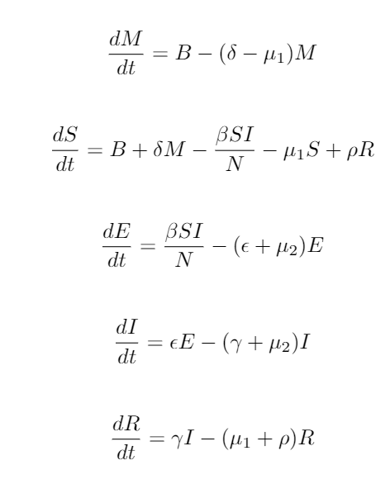
Model

Slide 4
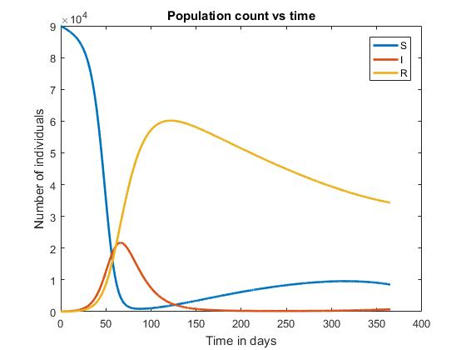
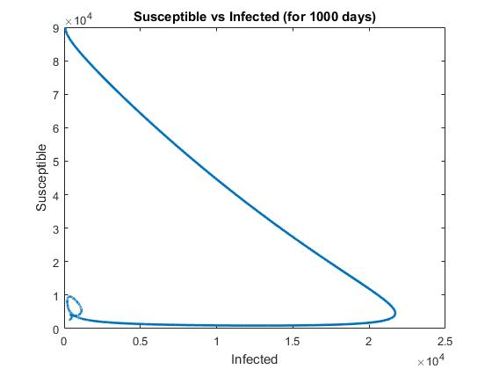
Deterministic approach simulation result

Slide 5
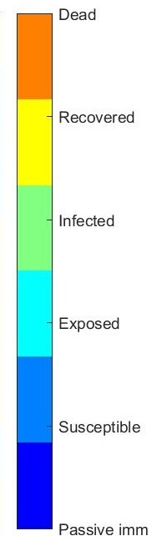
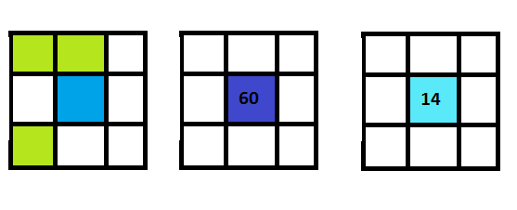
Modeling using cellular automaton - rules
Interaction term
Time stamp, MSEIRS
Latent period

Slide 6
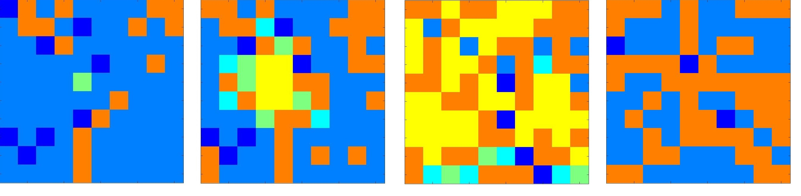
Modeling using cellular automaton
Step-1
Step-51
Step-151
Step-401

Slide 7
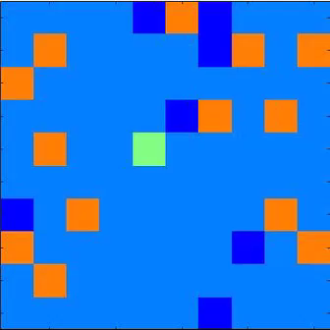
Modeling using cellular automaton

Slide 8
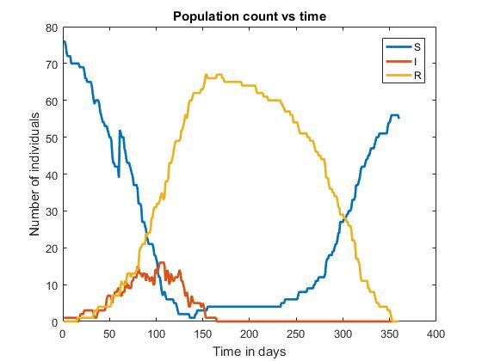
Comparison

Slide 9
Summary and Conclusion
Modeling with MSEIRS model.
The deterministic approach
The cellular automaton approach
Some things which do not depend on the local property, but depend on the overall number of people in the study, can not be included in the cellular automaton
The rules for the automaton were good enough to produce almost the same results as in the deterministic model.

Slide 10
Thank you

